Slide 1


Sustainable trails: a holistic approach
Dr Tom Campbell
Notes:
Sustainability, feels increasingly omnipresent, permeating through almost all aspects of our lives.. And Mountain biking is no exception, especially when it comes to mountain bike trails. I’m sure most, if not all of us here have an awareness of the issue of sustainability of mountain bike trails and probably have our own perspectives.
But, I’d like to take a step back and consider how philosophical and theoretical approaches to sustainability might be applied to mountain bike trails and to see whether we might learn lessons from the discipline of sustainability science. As a scientist, theory is important, but it is the application of the theory which I think really matters. how it can actually be applied to help us all to create more sustainable mountain bike trails is the important part of the picture. The chapter itself combines theory, and a little philosophy with practical recommendations

Slide 2
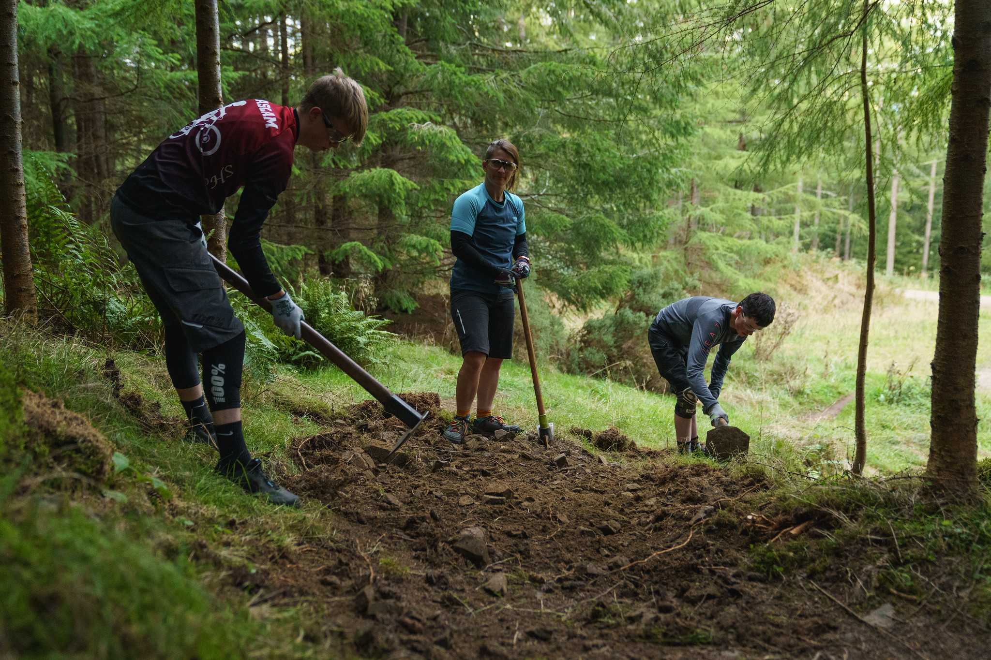
What is a
sustainable
trail?
What is a sustainable trail?
Notes:
So, let’s start right at the beginning by considering how we might actually define sustainable mountain bike trails..
As an academic – terminology is important.
This may seem like a fairly straightforward question but I think it’s important to get a little bit of clarity around this right from the outset. I’m sure we all have our own understanding of what this means and maybe different ways of prioritising different aspects. So, I’m inviting you consider this question for a moment…… What do you believe makes a sustainable trail?

Slide 3
Definition and Operalisation
We asked the following question as part of our research study into mountain bikers' attitudes, behaviours and motivations:
What do you consider to be a sustainable trail?
1555 mountain bikers provided a free text response.
What is a
sustainable
trail?
Notes:
Now, we asked this question as part of our relatively recent study on mountain bikers' attitudes, motivations and behaviours.
Outwardly this is a fairly straightforward question, but it was deliberately framed in this way – with the respondent's perception being central and the question being completely open. The analysis of this type of data is far more time consuming and involved than using a quantitative approach but we felt it important to firstly understand the full range of perspectives initially rather than attempt to define different themes or categories ourselves. And from a scientific perspective, this is actually an important exercise, it allows us to test our assumptions about a concept and acts as a bit of a check and balance – is it what we think it is, have we overlooked anything – how might other people's interpretations inform theoretical models etc.
We received 1555 free-text responses, which is a fairly decent sample and a lot of data to trawl through, especially as answers were provided in multiple languages and needed to be translated initially. I suspect that some of you in the room answered this survey, so if you did - thanks.

Slide 4
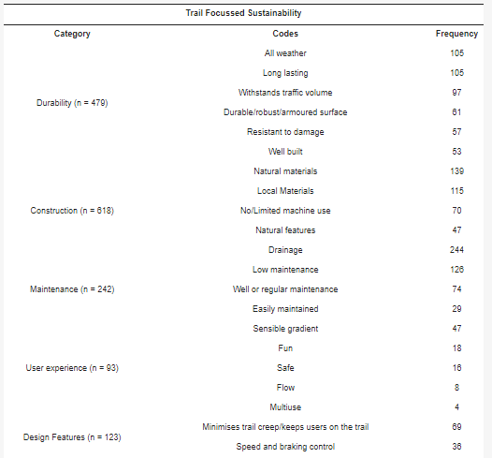
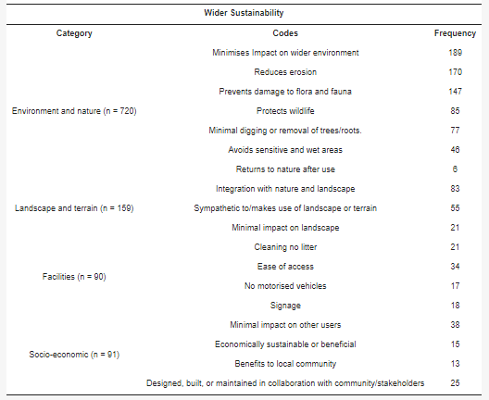
Many things, to many people
Content analysis of the question, “What do you consider to be a sustainable trail?” (n = 1555).
Campbell et al. (2021)
Notes:
And perhaps not surprisingly there was a vast range of definitions and characteristics. But we managed to make some sense of these and were able to arrange all responses in these main broad themes. And there was a clear distinction between aspects which related directly to the trail itself and those which related to the wider environmental and socio-economic factors.
In addition to the distinction between trail-specific factors and wider environmental factors we found that the areas that MTBers reported most commonly were…….
So there is a really wide range of definitions that were suggested. Arguably wider than it is possible to fully capture within this content analysis where we have taken a huge number of individual responses and identified commonality between them. This is important for a couple of reasons – first it points to the individual experience of sustainability – that I will come onto later, and also brings the elephant in the room into focus. There is no such thing as a sustainable trail, because it isn’t a binary concept – we don’t have a situation where trails are are aren’t sustainable – they exist on a continuum of sustainability, or perhaps on three.
So we have a lot of different understandings and experiences of trail sustainability. Which we will come to later.
Note that some of these refer to experience and behaviours – designing the trail to promote certain rider behaviours.

Slide 5
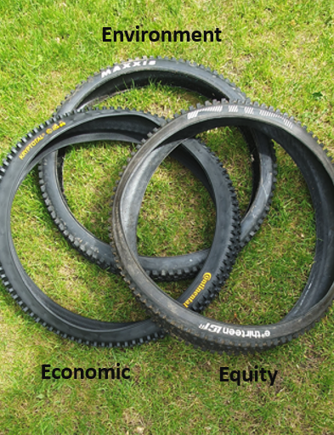
The Three “E”lements of Sustainability
Responses covered the three pillars of sustainability.
The IMBA Guidelines for a quality trail experience highlights the importance of considering all three for planning and decision making but acknowledges that the social (equity) aspect is often overlooked.
Approximately 70% of responses focused on environmental aspects with only 10% citing social or economic factors.
Notes:
OK, so the first important point to make is that sustainability encompasses three main aspects – environmental, economic and social. I’m sure most of us are aware of this but its worth remembering. Certainly the IMBA guidelines for quality trails highlight this and clearly state that the social aspect is often overlooked. And we’ll come back round to that in a wee while.
But there is definitely is a tendency to focus upon the environmental aspects of mountain bike trails. Indeed we found that nearly three quarters of MTBers cited environmental considerations.
However, I’m aware that frequency doesn’t necessarily mean the most important – and I’m certainly not suggesting that it does here. After all the question didn’t ask that. So all this tells us that the most commonly mentioned factors were environmental in nature.

Slide 6
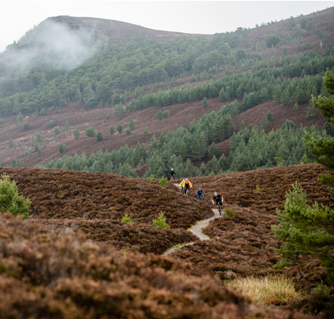
Environmental Focus
Trails are physically located within the environment and exist as tangible and visible artefacts.
As a relative newcomer to the outdoors, there was initially a desire to demonstrate the impact of mountain biking on the environment to justify our presence in the outdoors. Often relative to other users.
Early sustainability paradigms were predominantly anthropocentric in nature and focused largely upon improving efficiency, reducing harm, and mitigating (human) damage to the environment.
Much of the current knowledge base regarding trail sustainability has emerged from research focussing upon the impact of trail use upon soils, although environmental impact can extend to wider ecological components including vegetation disturbance of wildlife.
Notes:
Explanation:
And I certainly think is understandable both because the trails are physically located within the environment, often the natural environment and are therefore a tangible and visible artefact, And initially, as a relative newcomer to the outdoors, tensions with existing users were evident and therefore there was a desire to measure the impact of mountain biking on the environment with studies on erosion being common.
As a relative newcomer there was….Maybe think about adding details of the types of study being done at this stage – almost exclusively looking at the direct impact upon soils and vegetation – the bit that is easy to see. But also comparing the impact of MTB to other users.

Slide 7
The evidence base
It is relatively well established that all trail-based activities cause a degree of degradation of soil, with the effect generally being curvilinear and moderated by an interaction between environmental factors, user type and user behaviour.
The impact of mountain biking upon soils and vegetation has generally been shown to be equivalent to that of hikers and significantly less than that occurring from equestrian or motorised vehicular use.
Trails that include high grades and low slope alignments are generally associated with greater damage as is inadequate drainage or being located within wet areas.
Less studied are trail-related impacts to water quality.
Land management agencies have rarely funded the types of trail science studies needed to develop, refine, or validate trail sustainability BMP guidance, instead supporting more applied studies to inventory trails and assess trail conditions (Marion 2023)
Notes:
So what sort of evidence do we actually have of the impact of MTB trails on the environment. Well, there we know some things with a high degree of certainty. We know that trail use, by all users, causes some degradation of soil, and vegetation. We also know that MTBers are responsible for similar levels of impact as hikers but less than horses or vehicles. And we know that steep trails and poor drainage contribute to the extent of erosion etc occurring.
Greatest damage occurs with little use but with greater use the effects stabilise.
But actually, the evidence base is not particularly strong yet. Although Martyn's work clearly makes an important contribution to the field. Summarise the findings from the soil review.
Also more recent reviews since to make this point more clearly.

Slide 8
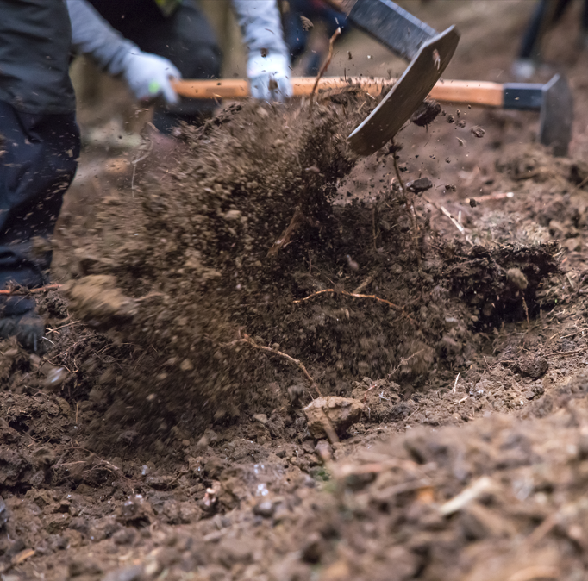
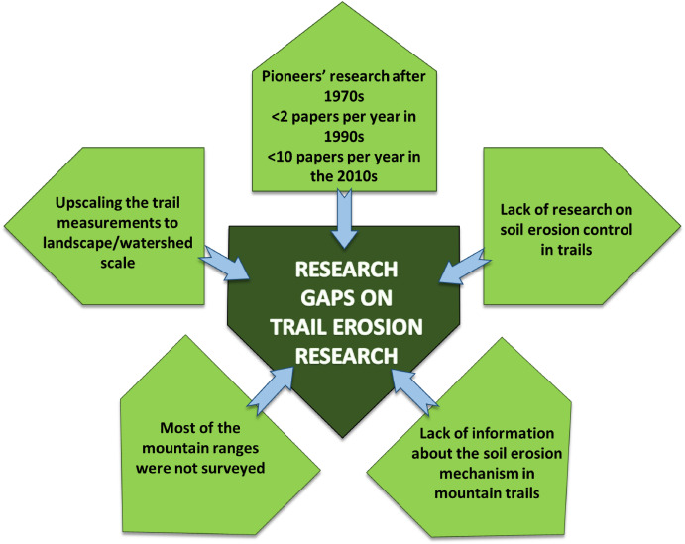
Limitations (Soil Research)
Notes:
So we must know a lot about what happens to the soils by now. Well – Yes – and No.
Sticking with soils at the moment – a recent review of the literature highlighted some significant limitations in terms of research methodologies and in the lack of diversity of locations etc. Conclusions are being drawn from a relatively small number of locations – and therefore the localised conditions are not being fully factored in.
From a pure science perspective there is a pressing need to research the connectivity of water flows and the role of trails on runoff generation and sediment yield at various locations.
There is also a need to research the mechanisms of the soil erosion process in trails – trampling effects, wheel impact, seasonal changes and temporal variation – variation across time.

Slide 9
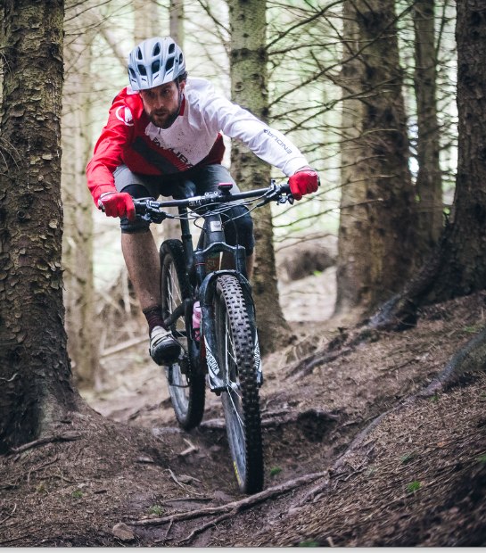
Wider (theoretical) Limitations/Challenges
  There is a lack of longitudinal research
  Carrying capacity seldom established
  Focus on measurement and description but lacking in potential approaches to mitigation
  Human behaviour often not included
  The aim should be to improve the user experience and allow a sustainable human-nature connection.
  Reductionist approach often measuring variables in isolation
Notes:
And there are some further difficulties in attempting to male definitive, and more widely applicable assertions. Important to note that this not a reflection of the quality or the rigour of the studies that have been carried out to date. This is to do with the type of questions that are being asked and that can be answered through the most commonly used approaches.
Much of the evidence base is based upon cross-sectional research, capturing a short snapshot in time.

Slide 10
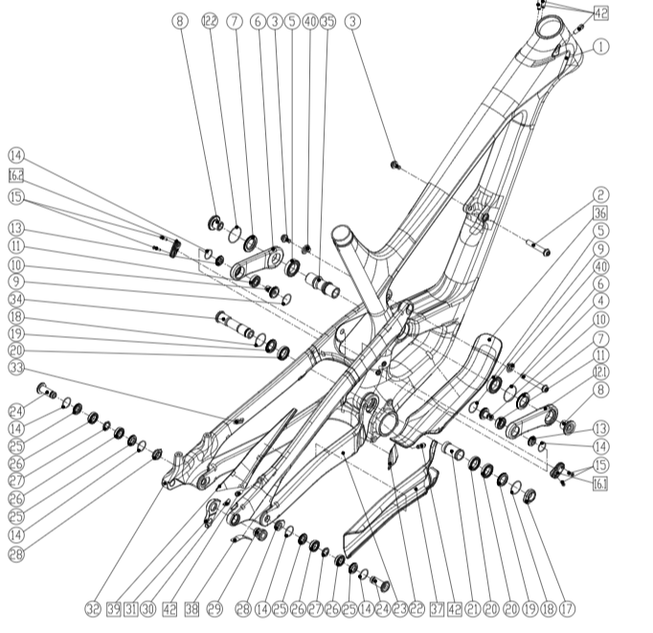
Reductionism v Holism
Reductionism may prevent scientists from recognizing important relationships between components or organisms in their natural settings, appreciating the evolutionary origins of processes and organisms
Scientists, for the most part, don’t know how to do holistic research. They are trained and rewarded for doing reductionistic science. Reductionistic studies generally don’t help solve sustainability problems because such studies are too narrowly focused, and humans are often not considered.
Answering a reductionist question about a phenomenon that may contribute to sustainability may be helpful, but in the end, reductionism alone cannot answer sustainability questions.
One of the problems of taking things apart and seeing how they work - supposing you're trying to find out how a cat works--you take that cat apart to see how it works, what you've got in your hands is a non-working cat. The cat wasn't a sort of clunky mechanism that was susceptible to our available tools of analysis. (Douglas Adams)
Notes:
Full disclosure – and this may be hard to believe but I’m not a philosopher. Or an environmentalist or an ecologist, although I appreciate that some of you in the room probably are. But in diving down the rabbit hole of sustainability I’ve indulged myself in ……
Similarly, considering a trail in isolation will help us learn about that trail and potentially to identify strategies for mitigation. But what about the surrounding trails, what about the wider trail network. If we adopt a more holistic philosophy then we are asking very different questions – how does what we do at this immediate location impact upon another. Which is where human behaviour becomes a very important variable. If we change a trail for instance, we might reasonably expect this to change rider behaviours – maybe they will ride it more and as a result reduce their use of other trails, or the opposite – it might no longer meet their needs and they elect to ride elsewhere.

Slide 11
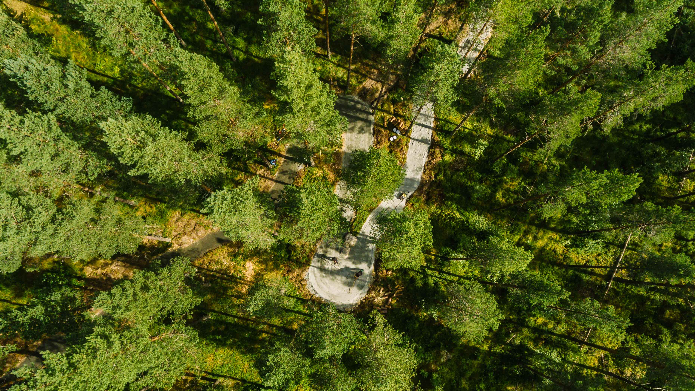
Holism
Considers ecosystem properties from a “top down” view, and thus is more holistic in nature.
Does not simply attempt to prove the effect of an independent variable on a dependent variable. Instead, the objective is to see how an ecosystem responds under a variety of conditions that could occur at the study site, not just those that existed at the time of the study.
We experiment with the model, changing one variable at a time, to see how changing them affects the range of outcomes that could occur at the study site. It also tells you what variable affects the prediction most, and what research must be taken next to improve your understanding. It is didactic. Most important, it keeps the researcher focused on the question that prompted the study in the first place.
Image credit P Lockhart
Notes:
IMPACT ON THE ENTIRE BIOSPHERE IS IMPORTANT
Outline the various potential impacts but then
It is a complex, dynamic system. Yes, we need to understand the mechanistic stuff but then apply it in a wider multidisciplinary context. We need both approaxches.

Slide 12
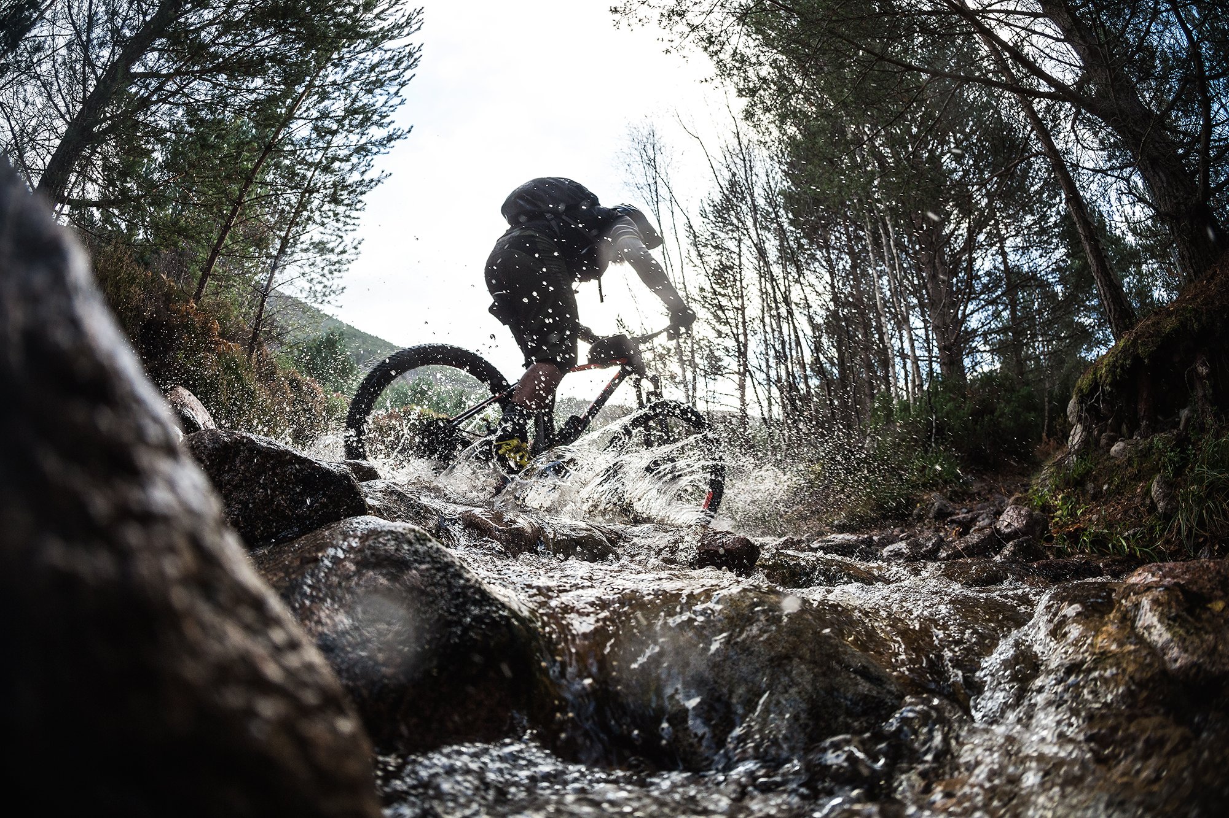
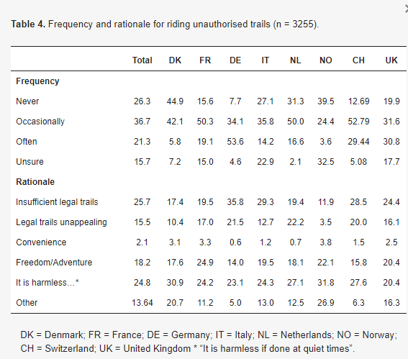
The Human Factor
The Human Factor
Rider behaviours are arguably the most important determinant of the ecological impact of trail use and therefore need to be fully understood in order to progress the discourse of sustainable trails
Unauthorised trail building has always been part of mountain bike culture but with growing numbers of riders the potential for negative impacts increases.
While purpose-built trail centres and bike parks can divert mountain bikers away from more sensitive areas thereby protecting ecosystems and reducing conflict (Taylor and Sand, 2021) they may not satisfy all riders’ appetite for natural technical trails.
The proliferation of unauthorised trail building during the Covid Pandemic supports the notion that mountain bikers desire certain types of trails and will create them where they don’t currently exist.
Notes:
We know that riding behaviours are a significant moderator for ecological impact of MTB, riding in the wet, skidding, tyre choice, littering, seed dispersion etc). but also notoriously difficult to measure (at least historically) as humans are complex.
behaviours – will ride what they want etc. May ride wet trails – will ride unauthorised trails.
So we really do need to factor the human into the equation!!
This is human nature to a large degree. And I’m making absolutely no judgements here about whether this is right or wrong. It’s about trying to understand what the picture is currently and why.

Slide 13

Regenerative – The new sustainable?
Resilience
Contemporary Sustainability – aims to maintain the status quo through mitigation. Prevent further degeneration.
Regenerative Sustainability – aims to manifest thriving and flourishing living systems.
Health of planet
Regeneration
Degeneration
Sustainability
Time
Notes:
Great, but still tends to be focusses upon reducing the impact – doing less bad – which is better than nothing but what about making things better?
And the truth of the matter is that contemporary approaches to sustainability haven’t worked.
DO MORE GOOD, improve the environment, economy, social aspects.
I appreciate that this may sound a little aspirational and I’m not suggesting that we can easily reach a place where we deliver benefits across of areas. However, I’m suggesting that we should start to change the narrative a little, accentuate the positive. Dial up the stoke a little.
And this doesn’t mean that we stop looking to measure the impacts of MTB, quite the opposite. It’s only by measuring the impacts across various contexts and outcome that we can begin to identify how we can make improvements etc. But that should be the aim, simply measuring what currently happens is not enough.

Slide 14
The Regenerative Paradigm
Holistic worldview
Thriving of all living systems
Inner and Outer Dimensions
Promotes potential and essence
Transformational change processes
Rather than seeing problems and solutions in the world, regenerative sustainability see living systems as existing in transitory states along a continuum of health and complexity.
Considers how contexts and environments influence worldviews and behaviours.
(Gibbons, 2020)
Regenerative
Social justice
Ecosystem viability
Complex adaptive systems
Contemporary
Conventional
Fragmentation
Anthropocentric
Managing nature & people
Minimum human wellbeing
Adapted from Gibbons (2020)

Slide 15
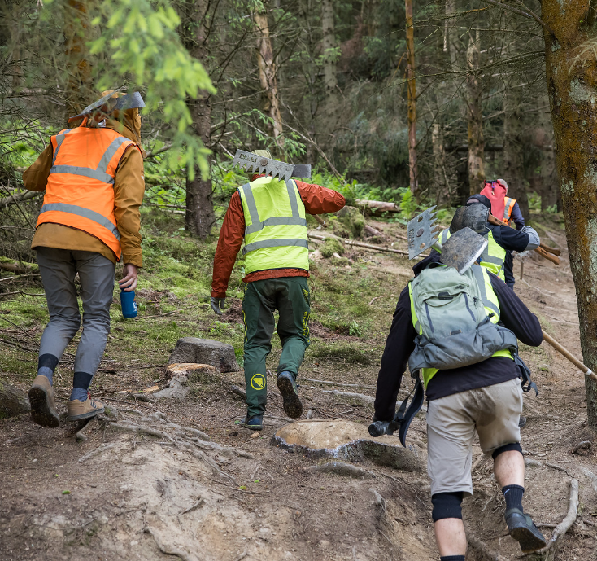
Implications
From a research perspective, the theoretical position that we adopt dictates the specific questions that we seek to answer. Moving away from a position of mitigation or “doing less harm” to one where we ask if and how can we do “more good” is a significant shift.
Potential to enhance the wellbeing of the entire biosphere through trail building practices. For example, promotion of revegetation and introduction or reintroduction of species to enhance biodiversity, or the creation of wildlife corridors.
The wellbeing of humans assumes some importance.
This consideration for the wider biosphere and a systems approach raises interesting questions regarding the approach to individual trails.
Notes:
So what does this mean in relation to MTB trails? Well, if we adopt a regenerative holistic approach to sustainability the question changes from how can we mitigate damage to this trail, or how can we enhance biodiversity in designing this trail to – how can mountain bike trails enhance the wider biosphere

Slide 16
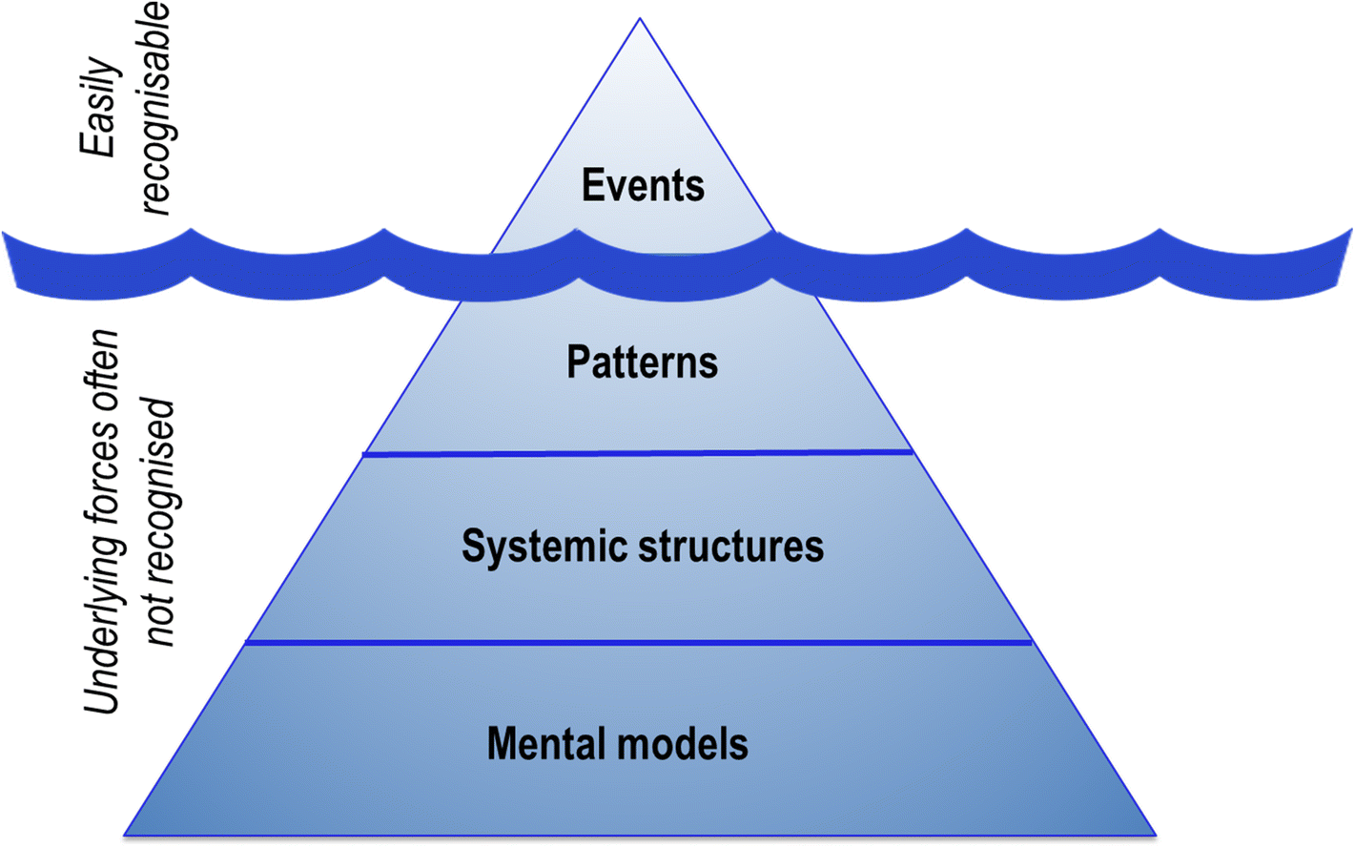
The importance of Inner Worlds
Central to the regenerative paradigm is an inner dimension of sustainability.
Contends that our inner worlds (our thoughts, emotions, identities and beliefs) are fundamental to solving sustainability challenges.
Deep leverage points – difficult to activate but truly transformational.
(Ives et al., 2020)
Notes:
A key element of the regenerative approach is the focus on the human being which introduces the concept of inner and outer dimensions of sustainability.
Despite growing global challenges for planetary sustainability and over 20 years of sustainability science – significant challenges for sustainability persist. We have not managed to really effect fundamental behavioural changes sufficient to halt negative impacts upon the planet. And it has been suggested that this may result from a pre-occupation with outer dimensions of sustainability and collective social structures with a lack of consideration for our inner worlds and inner dimensions of sustainability.
And seeking external solutions to external problems of sustainability may not be the best approach.
Our inner worlds may have the greatest potential for transformative change.
The deepest levels of this are our mental models, the filters that we experience the world through. These underpin our systemic structures and the patterns and events that we seek to understand – the type of scientific questions that we ask. The capacity to question and critiquing our own mental models and adopt new paradigms may lead to significant changes.
Deep leverage points – difficult to activate but truly transformational
. How do mountain bike trails promote our inner dimension of sustainability and does this drive wider behaviours and attitudes etc.
And yes, yes it does. Maybe.

Slide 17
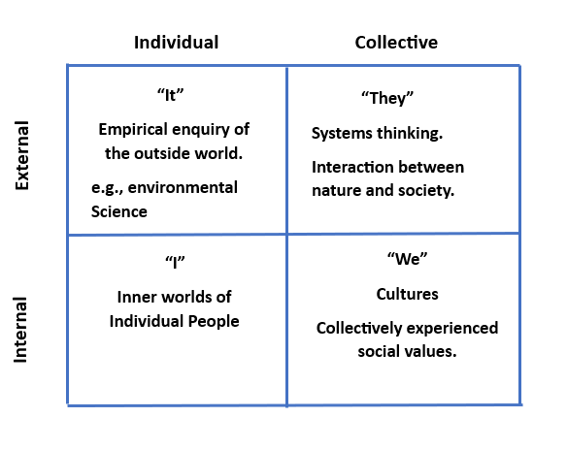
Realms of Enquiry
What are the rates of erosion or Δ in levels of vegetation cover within a trail corridor?
How does rider behaviour impact upon rates of erosion or vegetation cover?
How might societal norms impact upon pro-environmentalism?
What are the inner factors that influence rider behaviours in respect of the environment?
Adapted from Ives et al. 2020
Notes:
We can consider sustainability to exist across two dimensions of reality – an internally versus externally experienced dimension and a collective versus individual dimension.
Therefore, we have 4 domains of sustainability

Slide 18
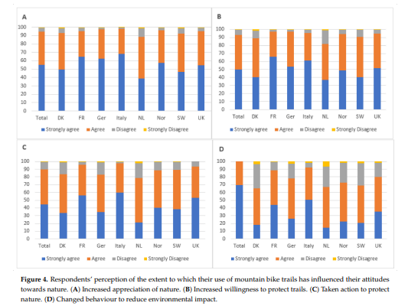
Attitudes and Behaviours
Connection to nature has been reported as a common motivation for participating in MTB (e.g., Roberts, 2018).
We found evidence of the same but also that participation in MTB resulted in ↑appreciation of nature, ↑willingness to protect trails and positive changes to environmental behaviours.
However, cross-sectional design and no attempt to explore the development of inner dimensions of sustainability.
Notes:
This is consistent with previous findings but is not without methodological limitations, cross-sectional, self reported data. We could assume that there is some evidence however of inner dimensions of sustainability being developed here.
We certainly need more research to explore this phenomenon longitudinally and in more detail. What is the baseline, what do these changes actually look like? What initiates them and how do they manifest?

Slide 19
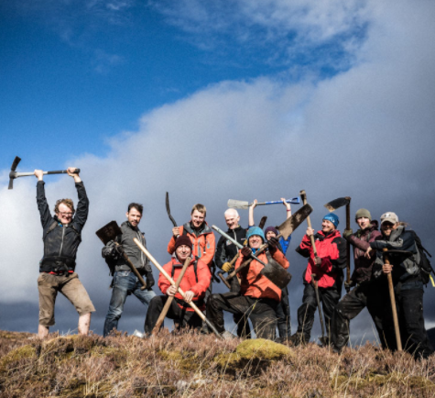
Pro-environmentalism
TCOYT - promotes volunteer-based trail maintenance and highlights all trail repair, clean-up and build efforts from trail crews and volunteers across Europe. In 2022 alone, over 6900 volunteer hours were contributed through this initiative (IMBA, 2023).
Trash Free Trails - community-focused, non-profit organisation which aims to reconnect people with nature through the simple yet meaningful act of removing single-use pollution from wild places. In 2022, TFT removed over 7000Kg of rubbish from 9775km of trails through 2810 volunteer hours.
Marin Tidy Trails - also seeks to mobilise the mountain bike community in removing litter from trails through trail tidy days and campaigning.
Notes:
Just some examples.

Slide 20
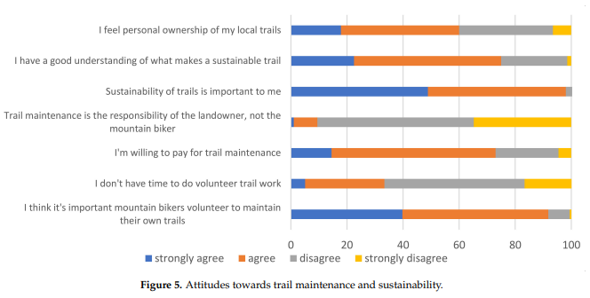
Trail Associations: Holistic Practice?
The practical benefits of TAs are manifold, but they also have an important role to play in promoting inner dimensions of sustainability and in promoting social and equity benefits.
Voluntary participation in recreation and conservation projects can enhance awareness of environmental issues (Asah and Blahna 2012; Molsher and Townsend, 2015) and lead to attitudinal shifts (indicative of increased inner sustainability) and improved stewardship (Dresner and Fischer 2013; Schild, 2018).
However, alongside environmental reasons, the social and fun aspects of volunteer trail building activity have been shown to be important motivations for participation which might contribute to the development of inner dimensions of sustainability (Kamei, et al., 2016).
Notes:
OK, So I think we probably all understand how important trail associations have become and the important role they play in promoting sustainable trails. Don’t worry though - I’m not about to claim that TAs as a panacea – I’ll leave that for them to do themselves – but
When viewed from the perspective of regenerative sustainability, it appears likely that participation in mountain biking is influencing an internal dimension of sustainability (evidenced through reported attitudes) and driving pro-environmental behaviours that extend beyond the boundaries of the trail itself. out the role of the trail associations?
Key thing here is how this theoretical conceptualisation can influence what the trail association sets out to do. Yes, the trail work is valuable but the wider….is equally important.

Slide 21
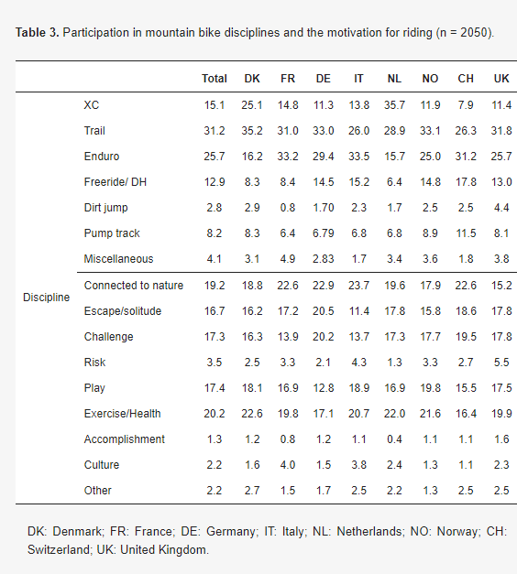
Social sustainability
MTB encompasses a broad range of riding styles and disciplines.
Motivations for participation are similarly diverse.
This may have implications for the development and maintenance of identity.
In turn this affects social identity and our sense of social norms and sense of community.
Some riders desire extreme, natural trails.
‘unauthorised’ trails can, under certain circumstances, make an important contribution to local economies, provide physical and mental health benefits, offer sporting challenges, and provide a connection with nature (National Access Forum Scotland, 2018).

Slide 22
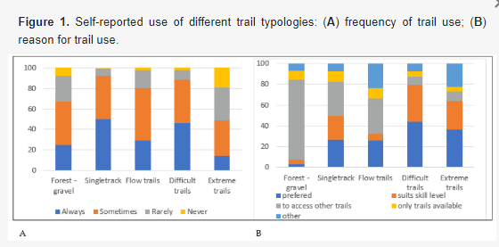
Unauthorised trail use?
Most European riders admit to using illegal or unauthorised trails (Zajc, 2016; Campbell et al., 2021) and, perhaps unsurprisingly, use of unauthorised trails is greatest in countries where riders report a shortage of appropriate legal trails.
But little is understood about the motives for building and using such trails although anecdotal evidence suggests that unsanctioned trails are often initiated by underrepresented groups who are unsatisfied with sanctioned trails, often citing predictable man-made features and perceived sanitation as undesirable elements of official trails (AMB Magazine, 2021).
Notes:
So, this has implications for inclusion and diversity.
Prohibition and Covid etc.

Slide 23
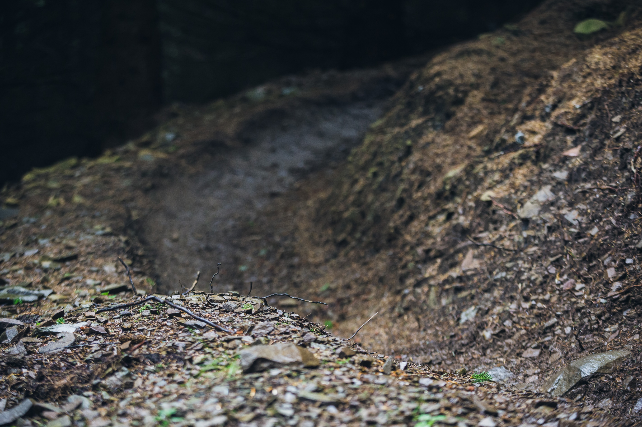
Implications
Raises questions about local versus global sustainability.
How might we choose to prioritise the immediate sustainability of any given trail versus wider planetary benefits?
What about wider trail networks? Do all trails need to be built to the same standard?
What about short-lived trails and less sensitive areas?
Can we sacrifice trails to promote overall sustainability?
How can we promote equity through provision and location of different types of trail?
Notes:
But…what about unauthorised trail use and riding in wet conditions etc?
How does availability of preferred trail types influence this?
We also know that riders will largely ride what they want and if it is not available they will build it etc. How does this fit with inner dimensions?
What ab
When viewed from the perspective of regenerative sustainability, it appears likely that participation in mountain biking is influencing an internal dimension of sustainability (evidenced through reported attitudes) and driving pro-environmental behaviours that extend beyond the boundaries of the trail itself. out the role of the trail associations?

Slide 24
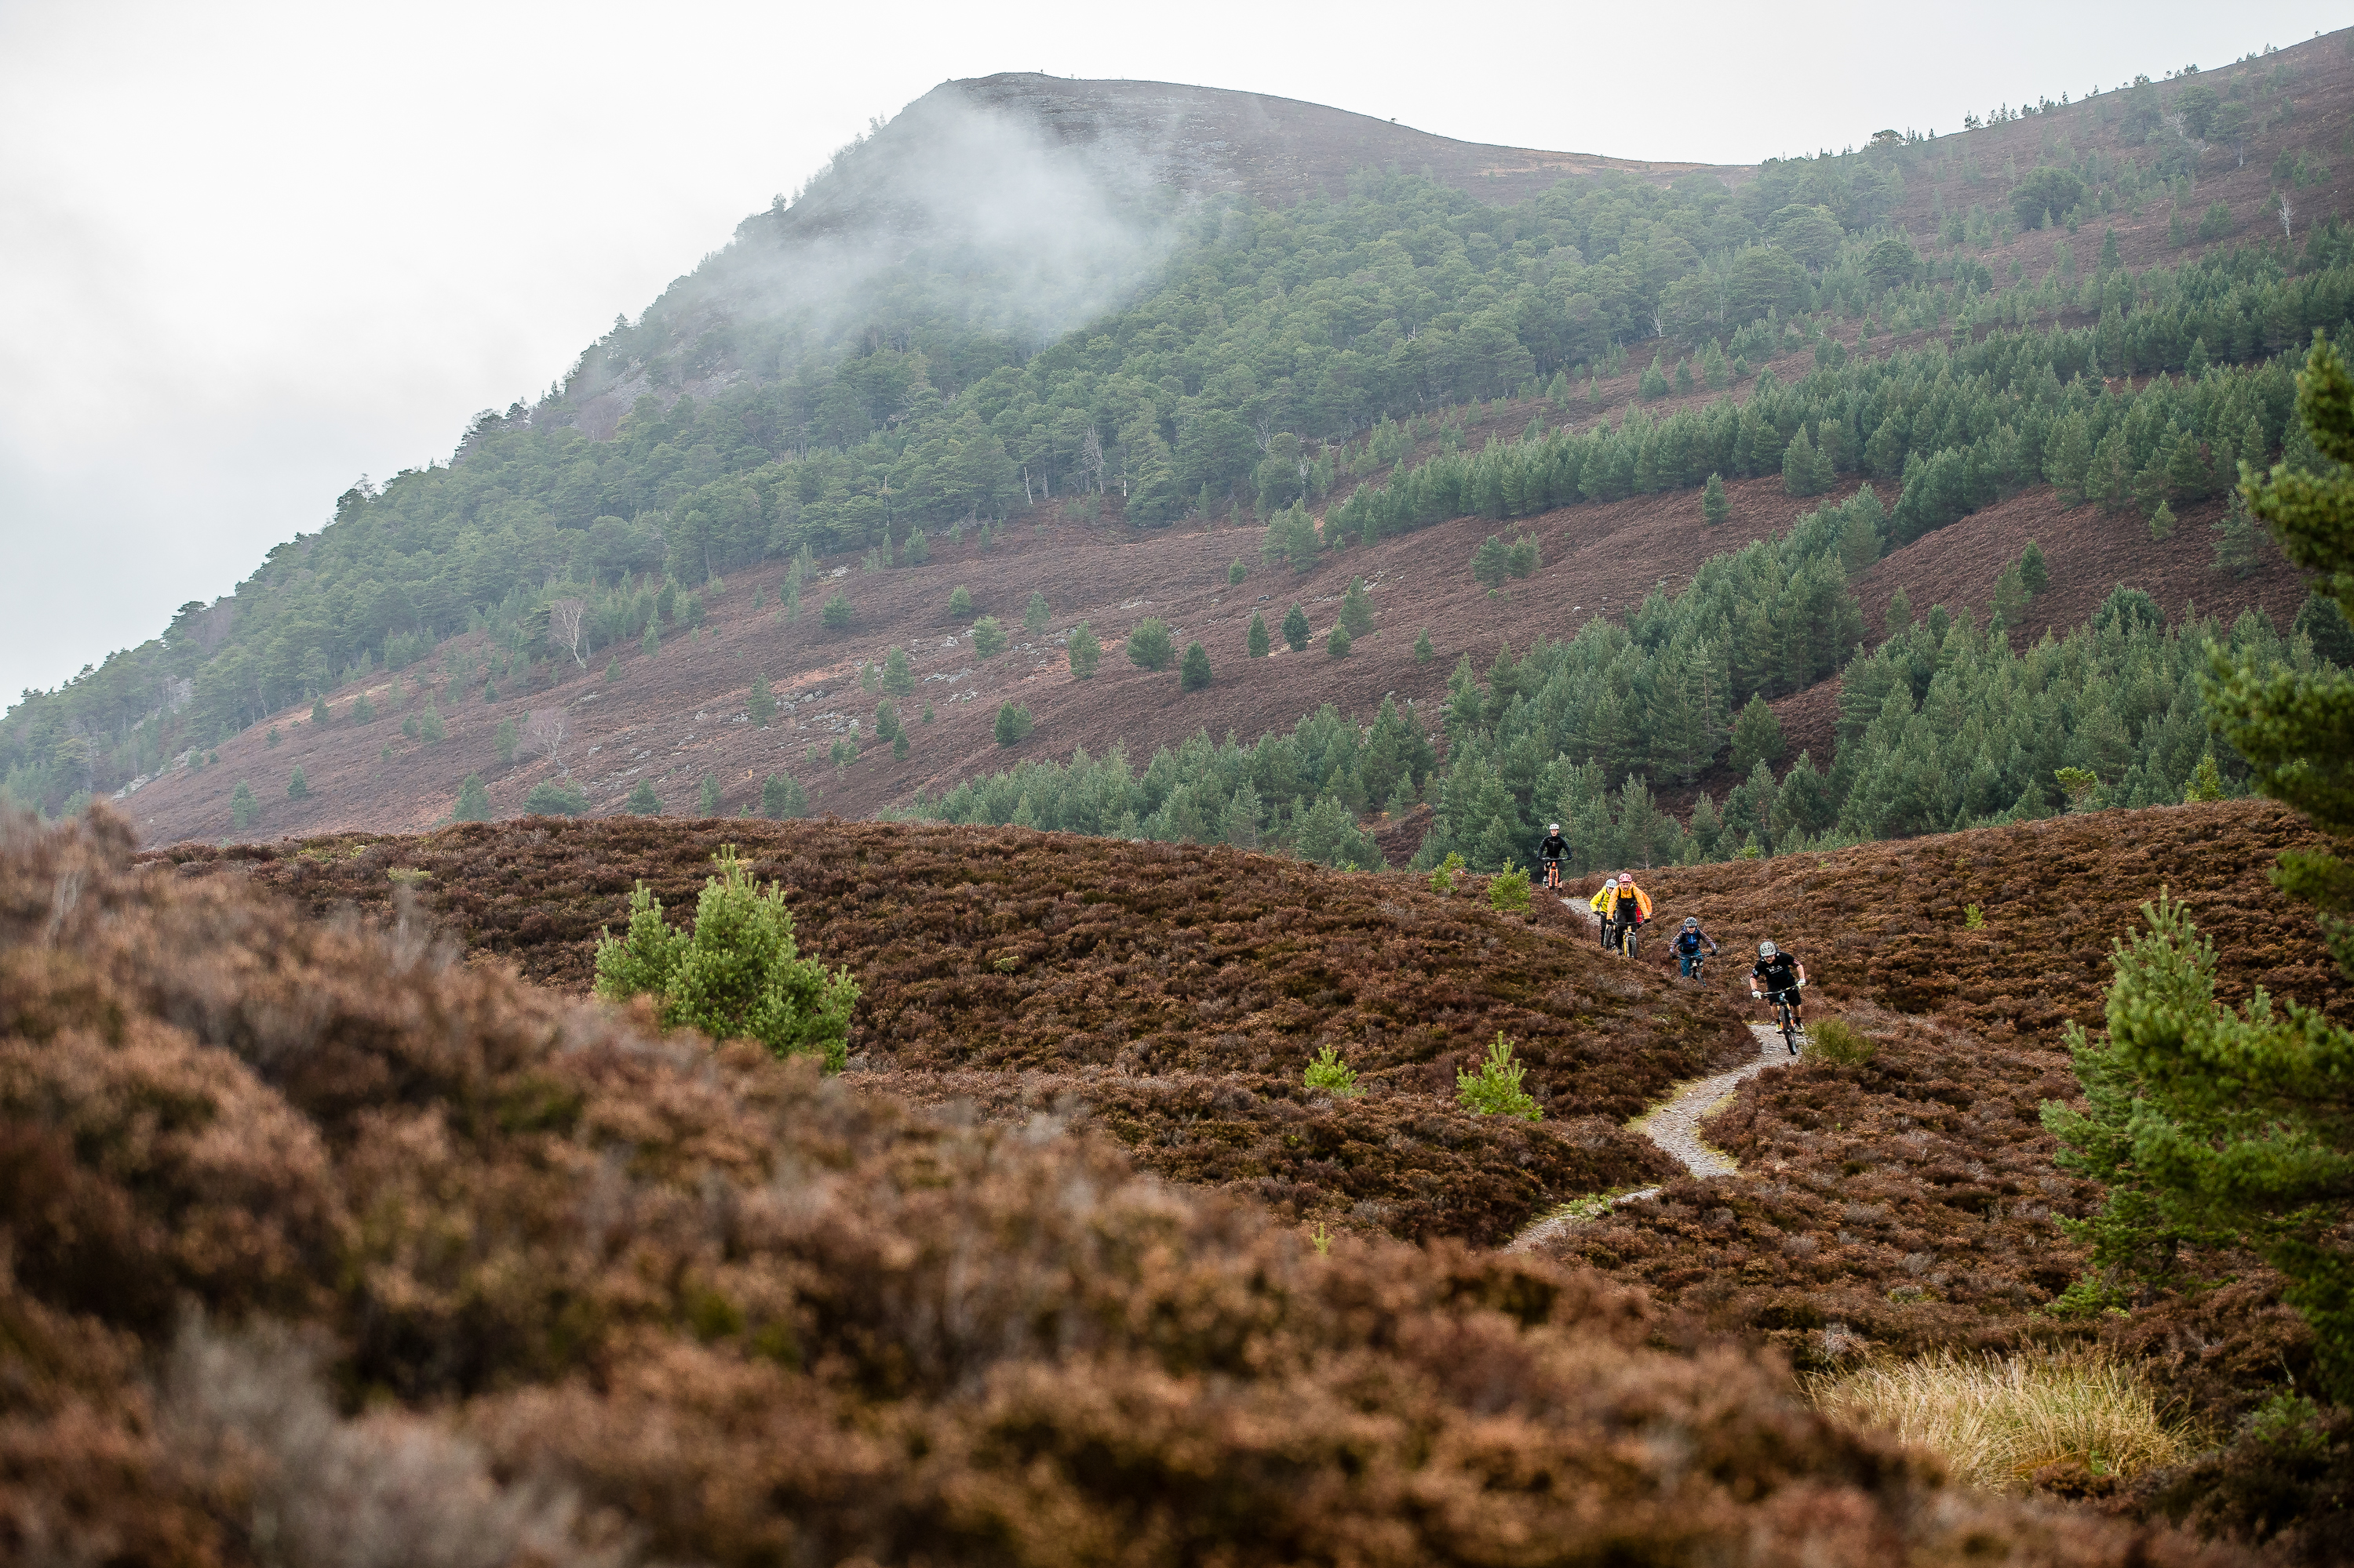
The trail to regenerative sustainability
Requires complementary holistic and reductionist research to improve the evidence, not just of the impact of MTB upon the environment but of strategies for mitigation and also regeneration.
Explicitly acknowledge the role of the human and of inner dimensions of sustainability with consideration for wider pro-environmental benefits.
Develop dynamic frameworks which consider the balance of environmental, economic and equality sustainability based upon best available evidence.
Integrate sustainability within educational provision for trail planners, designers, builders etc.
Adopt a systems approach which considers the overall health of the wider trail system, local economy and opportunities for equity.
Promote opportunities for equity, embrace all riding levels, cultures and styles.
Notes:
Insert another trail image here

Slide 25
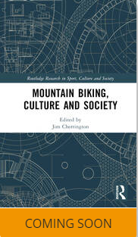
Final thoughts
This book represents the first critical examination of the social, cultural, and political significance of mountain biking in contemporary societies.
Part I: Mountain Biking Identities
Part II: Mountain Biking Bodies
Part III: Mountain Biking Environments (Sustainable Mountain Bike Trails: Towards a Holistic Approach)
Part IV: The Cultural Politics of Mountain Biking
'Mountain Biking, Culture and Society is the definitive text for anyone interested in understanding mountain biking as a sport, practice, community, identity, and embodied experience. It brings together the most cutting-edge research from scholars around the world, each advancing new ways of thinking about sport, moving bodies, technologies, and the environment. This is highly recommended reading for critical and social scholars of sport, physical culture, action sports and outdoor recreation, as well as those passionate about mountain biking.'
Professor Holly Thorpe, University of Waikato, New Zealand
Notes:
Now, this isn’t JUST an attempt to promote the book although…but the fact that there is an increasing body of academic work centred on mountain biking is significant and reflects the maturity of the sport and I’d like to think it adds weight to the legitimacy of it to those not involved in it. It’s really hard sometimes to remember that there are actually some people out there who aren’t completely consumed by MTBing, but it’s true. Anecdote about my colleagues querying the attention being given to such a niche sport etc. Anyway, the point is that pointing an academic lens at the sport can be helpful for a number of reasons – attracting funding, enhancing the veracity of findings and projects etc and, in the case of trails – promoting our right to be in the outdoors and attending to the nuances.

Slide 26
References
Campbell, T.; Kirkwood, L.; McLean, G.; Torsius, M.; Florida-James, G. Trail Use, Motivations, and Environmental Attitudes of 3780 European Mountain Bikers: What Is Sustainable? Int. J. Environ. Res. Public Health 2021, 18, 12971.
Fang F. C, Casadevall A. (2011) Reductionistic and holistic science. Infect Immun. Apr;79(4):1401-4.
Gibbons, L. V. (2020) Regenerative – The New Sustainable. Sustainability,
IMBA (2017) Guidelines for a Quality Trail Experience
Ives, C.D., Freeth, R. & Fischer, J. Inside-out sustainability: The neglect of inner worlds. Ambio 49, 208–217
Jordan, C.F. (2013). Holism vs. Reductionism in Environmental Science. In: An Ecosystem Approach to Sustainable Agriculture. Environmental Challenges and Solutions, vol 1. Springer, Dordrecht.
Marion, J (2023) Trail sustainability: A state-of-knowledge review of trail impacts, influential factors, sustainability ratings, and planning and management guidance, Journal of Environmental Management, 340.
Roberts L, Jones G, Brooks R. Why Do You Ride?: A Characterization of Mountain Bikers, Their Engagement Methods, and Perceived Links to Mental Health and Well-Being. Front Psychol. 2018

