Slide 1



Impact 2023 – The Power of the Bike
A framework for Scottish Cycling to deliver success and impact, inspired by the 2023 UCI Cycling World Championships

Slide 2
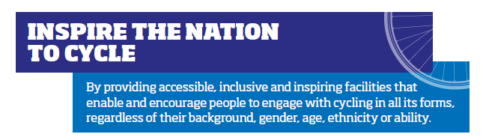


Objectives

Slide 3
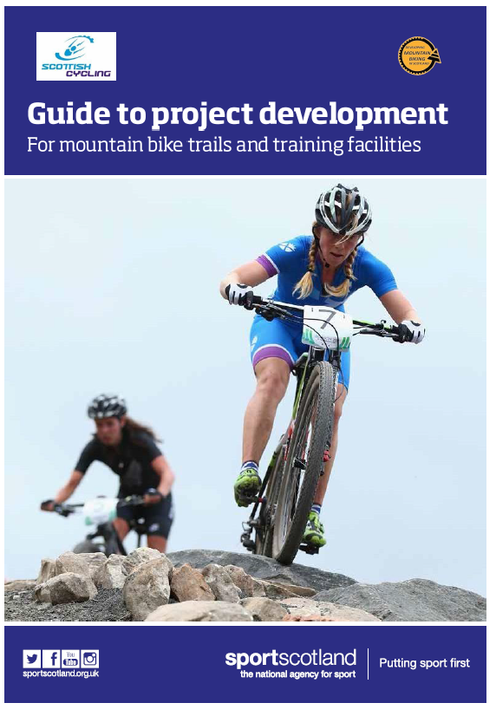
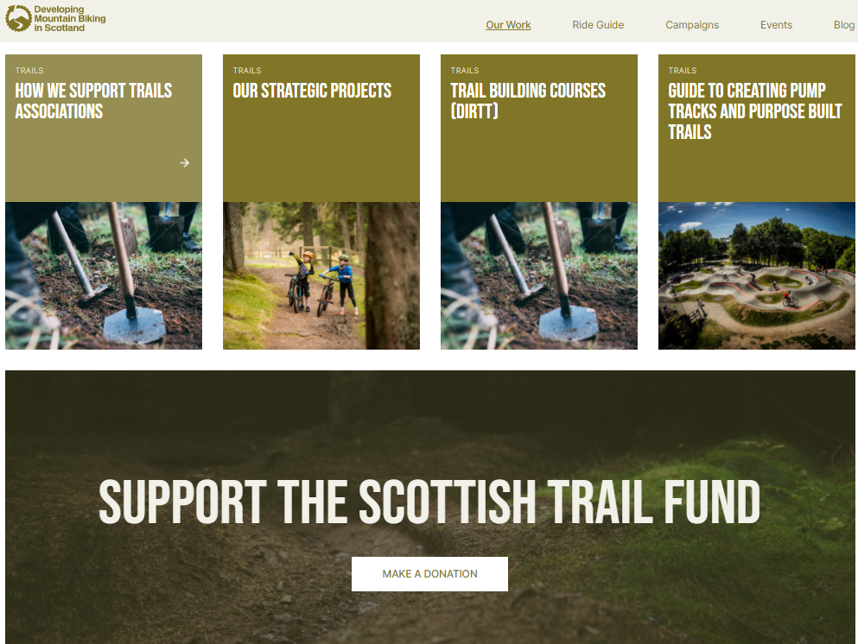
Intro to Project Management Guide

Slide 4
Stage 0: Strategic Definition
Expression of Interest Stage
Create a simple document that outlines your idea
Set up a project delivery group
Site considerations

Slide 5
Stage 0: Strategic Definition
Initial scoping of the need for the project
What is your project?
How do you know you need the facility?
Who would use the facility? Consider Equality, Diversity and Inclusion.
How can you evidence and record need e.g. by public meetings, questionnaires or survey?
Does your idea deliver for the local community now and in the future?
Will it meet the needs of target groups? i.e. deprivation, health……
Benchmark your idea against other facilities.
What is the population base? How many people live in the area?

Slide 6
Stage 0: Strategic Definition
Initial scoping of the need for the project
What is your project?
How do you know you need the facility?
Who would use the facility?
Does your idea deliver for the local community?
Will it meet the needs of target groups?
Benchmark your idea against other facilities
How many people live in the area?
What is your proposed site? Opportunities and constraints?

Slide 7



Cycling Facilities Fund – Consider Strategic Context

Slide 8

Multi-Discipline Hubs

Slide 9
Stage 0: Strategic Definition
Developing the needs analysis – Informal Users
Informal = users not part of an organised group
How to evidence the need?
  Surveys
  Engage schools
  Community drop-in sessions
  Local Authority (Active Schools, Community Sports Hub)
  Online petitions

Slide 10
Stage 0: Strategic Definition
Developing the needs analysis – Organised Groups
Cycling clubs, school cycling clubs, scout/guide groups, youth groups, Third Sector
Why are they important?
  Access to cycling, rider pathway, events, potential income (?)
Capturing the impact of your facility on organised groups
Can/will the facility create new clubs/groups?
Think evidence, evidence, evidence
  Surveys, letters of support/intent, capture numbers of coaches/leaders, increase in participants

Slide 11
Stage 0: Strategic Definition
Site Considerations
Security of Tenure – 20 years minimun
Only one suitable location or are there several options?
SWOT (strengths, weaknesses, opportunities & threats) analysis on all of the site options?
Fit with the regional provision of existing facilities?
Duplicate or compliment existing facilities, does it fill gaps in provision, and does it offer additionally?
Do any of the site options offer additional business, tourism or health potential?

Slide 12
Stage 0: Strategic Definition
Site Considerations
Security of Tenure – 20 years minimum
Only one suitable location or are there several options?
SWOT (strengths, weaknesses, opportunities & threats) analysis on all of the site options?
Fit with the regional provision of existing facilities?
Duplicate or compliment existing facilities, does it fill gaps in provision, and does it offer additionally?
Do any of the site options offer additional business, tourism or health potential? Consider match funding

Slide 13
Stage 0: Strategic Definition
Budget and Funding
Identify a rough budget for the project – Inspire or Strategic
Research and create a list of funders to approach initially
  Local Authorities, Trusts, Community Regeneration, Waste Funding, Windfarms
Identify likelihood and potential levels of funding (don’t assume Max award!)
Do you need to revisit your initial concept?

Slide 14
Stage 1: Preparation & Brief
Identifying gaps and Professional Support
Inspire or Strategic
What do you not know about your project?
What professional services are required?
  Design of cycling elements, supporting facilities, detailed budget breakdown, economic/health outcomes quantified

Slide 15
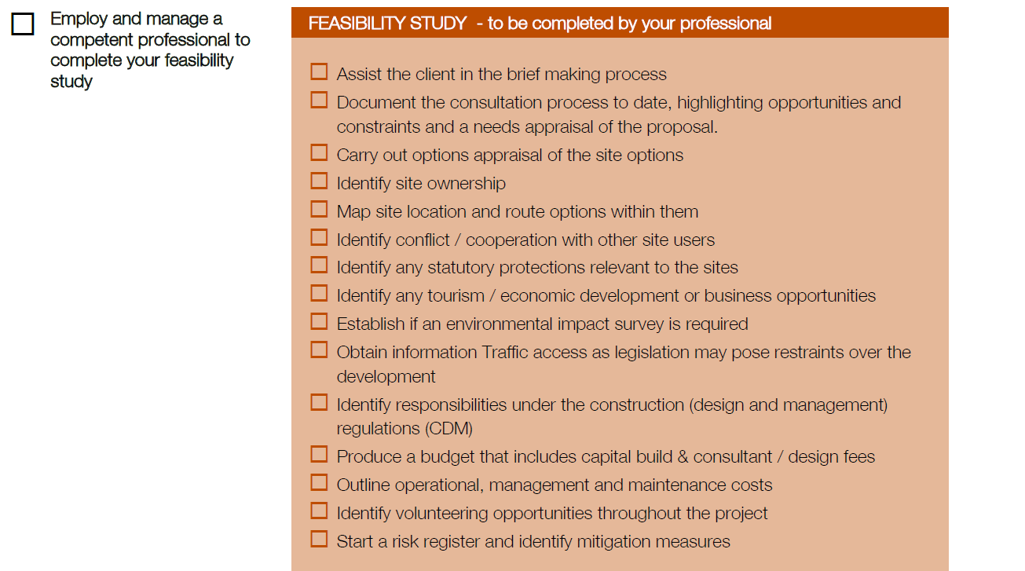
Stage 1: Preparation & Brief

Slide 16
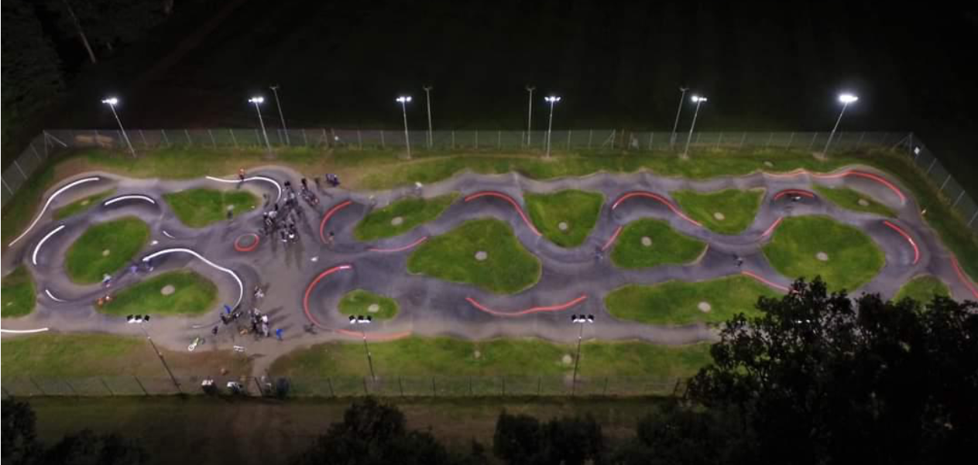
Stage 1: Preparation & Brief
CAN WE ADD A BASIC PUMP TRACK DESIGN TO THIS SLIDE
Use it to talk about how we don’t need totally detailed for Inspire projects (other funders may require though)

Slide 17
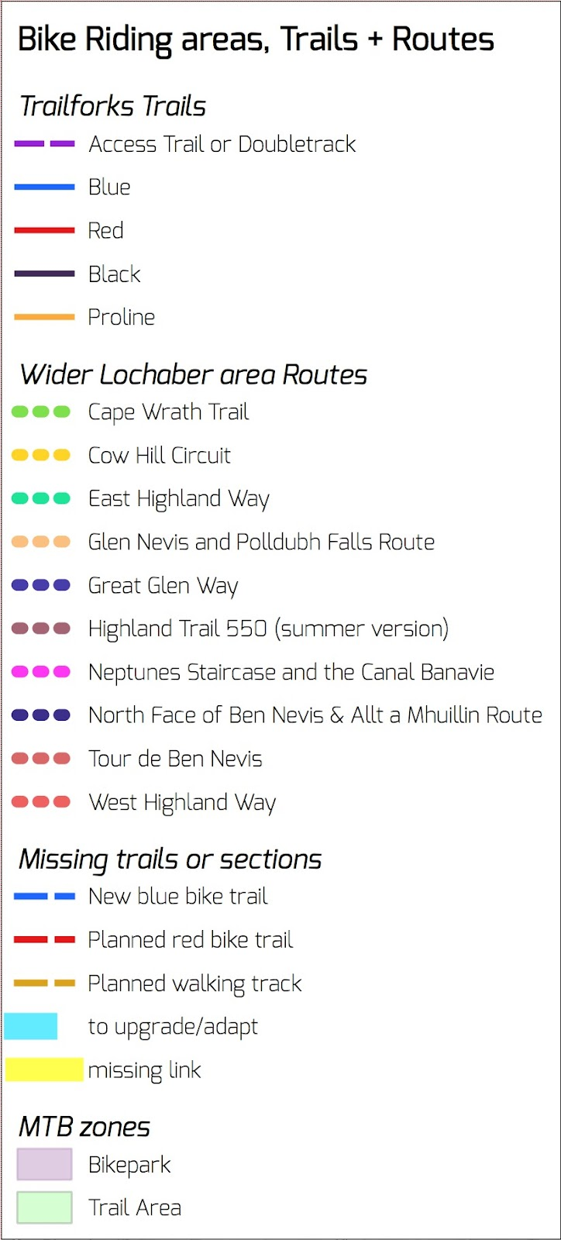
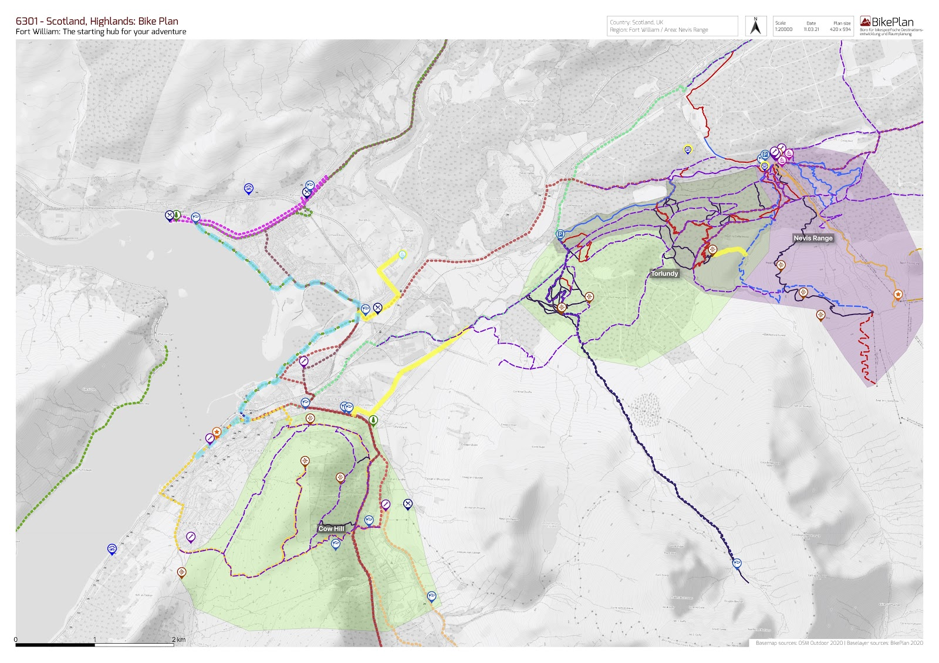
Stage 1: Preparation & Brief

Slide 18
Stage 1: Preparation & Brief
Review your Sport Development Outcomes
Clubs – who will use or is new facility needed
Schools
Other organized groups, Third Sector
Contact existing facilities of similar scale/location – understand their user numbers

Slide 19
Stage 1: Preparation & Brief
Funding Secured
CFF – unlikely to be first funder
All contracts in place
Security of tenure on land
CFF conditions of contract in award letter
Planning permission (can be done as you finalise funding applications)

Slide 20
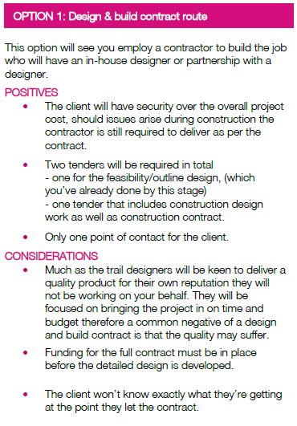
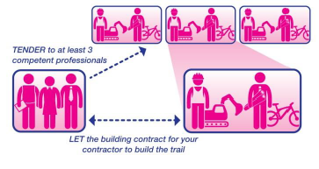
Stage 2: Concept Design

Slide 21
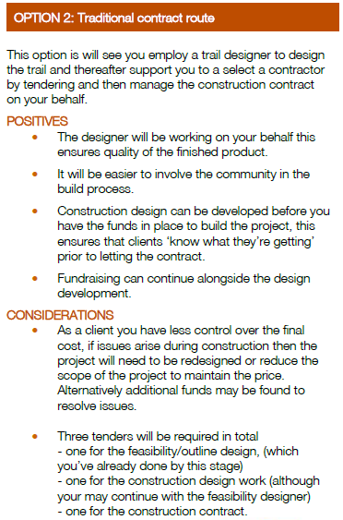
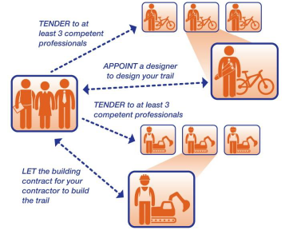
Stage 2: Concept Design

Slide 22
Stage 3&4: Detailed/Technical Design
Design & Build
  Identify possible contractors
  Prepare tender
  Develop scoring system
  Tender
    Include your schedule of services
  Select a competent contractor to design & build your facility

Slide 23
Stage 3&4: Detailed/Technical Design
Traditional Contract Route – Designers (Architect)
  Identify possible designers
  Prepare tender
  Develop scoring system
  Tender
    Include your schedule of services – including detailed design and bill of quantities
  Select a competent designer to design your facility

Slide 24
Stage 3&4: Detailed/Technical Design
Traditional Contract Route – Build Contractor (Builders)
  Identify possible builders
  Prepare tender (your designer should assist with this stage)
  Develop scoring system
  Tender
    Include your schedule of services – including detailed design and bill of quantities
  Select a competent builder for your facility

Slide 25
Stage 5: Construction
  Monitoring Quality and CDM
  Set out a ‘request for change’ procedure
  Agree the CDM for the project
  Agree frequency of site visits
  Monitor the quality of the build
  Monitor the CDM for the project
  Monitor the budget
  Complete the construction phase (including Practical Completion certificate)

Slide 26
Stage 6: Handover
  Finalising the Contracts
  Create a defects log
  Signage
  Plan your official opening
  Ongoing maintenance & inspection plan
  Benefit of risk assessment
  Continue to evaluate and get feedback
  Accident reporting

Slide 27
Stage 7: In Use
  The Fun Bit
  Monitor usage through counters
  Qualitative user surveys (if possible)
  Engage with clubs and organized groups – evidence of their growth will help future funding bids
  Implement your maintenance/inspection bid
  Run awesome events
  Go Ride!!!

Slide 28
Questions?

